Slide 1

Pisces

Slide 2

Meet Steve.
Steve wants to harness the power of AI to make informed investment decisions.
Steve
Investor

Slide 3
…but he struggles with…
Filtering relevant information.
Utilising AI prediction models.
Trusting model performance.
Steve
Investor

Slide 4

Even when he can, he doesn’t understand the results.
How?
Steve
I just
do it!
Investor
AI
99%
Model Accuracy

Slide 5




Pisces opens the AI Black-Box for Investors
Actionable Investment Insights
Driverless
AI Interpretations
Marketplace for Prediction Models
Blockchain-based
Model Performance Tracking

Slide 6



Subscription-based Business Model
Prediction-Model
Explainable
Stock Predictions
Reward
Model
Contributor
Investor
Subscription
per Model
Data
Reward
Data
Contributor

Slide 7

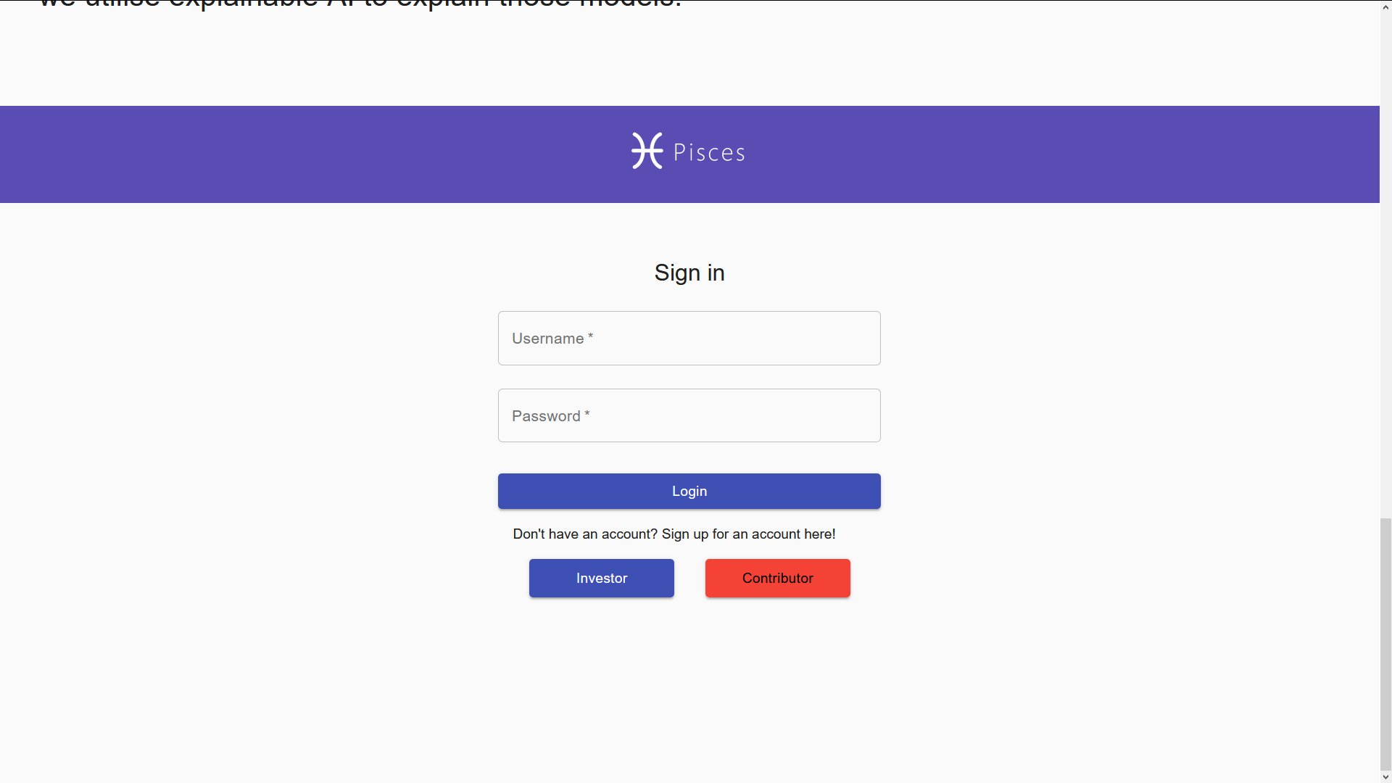
Investor’s Experience
Prototype Demo

Slide 8
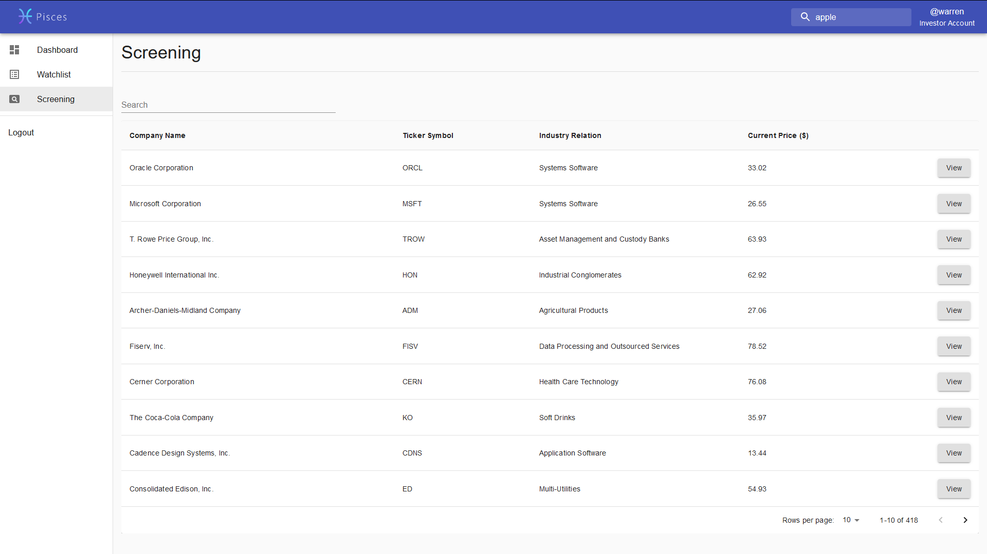
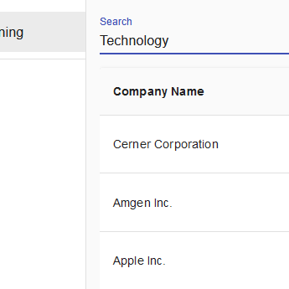
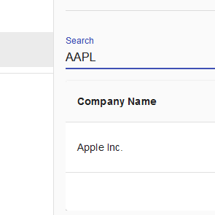
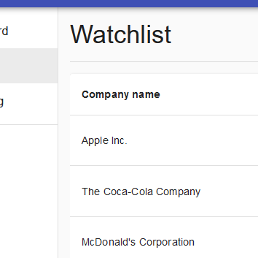
Stock Screening
Screen Industries
Search Stocks
Add to Watchlist

Slide 9
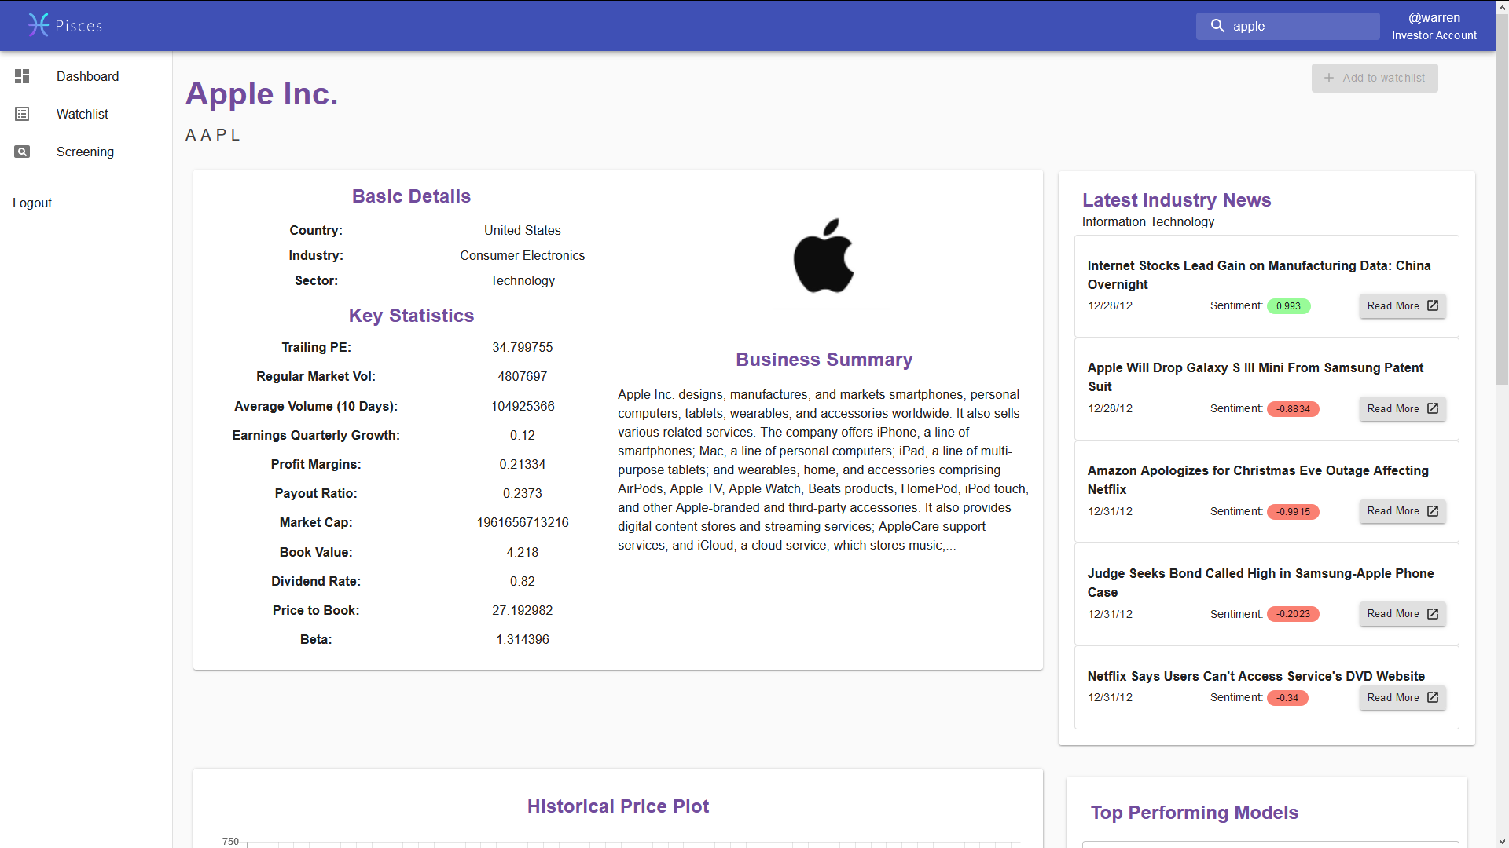

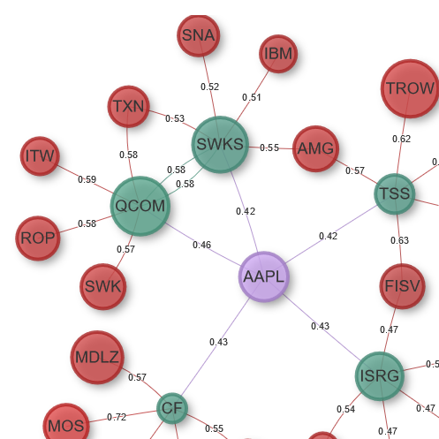
Company Insights
Review Key Statistics
See Market Sentiment
View Company Relations

Slide 10
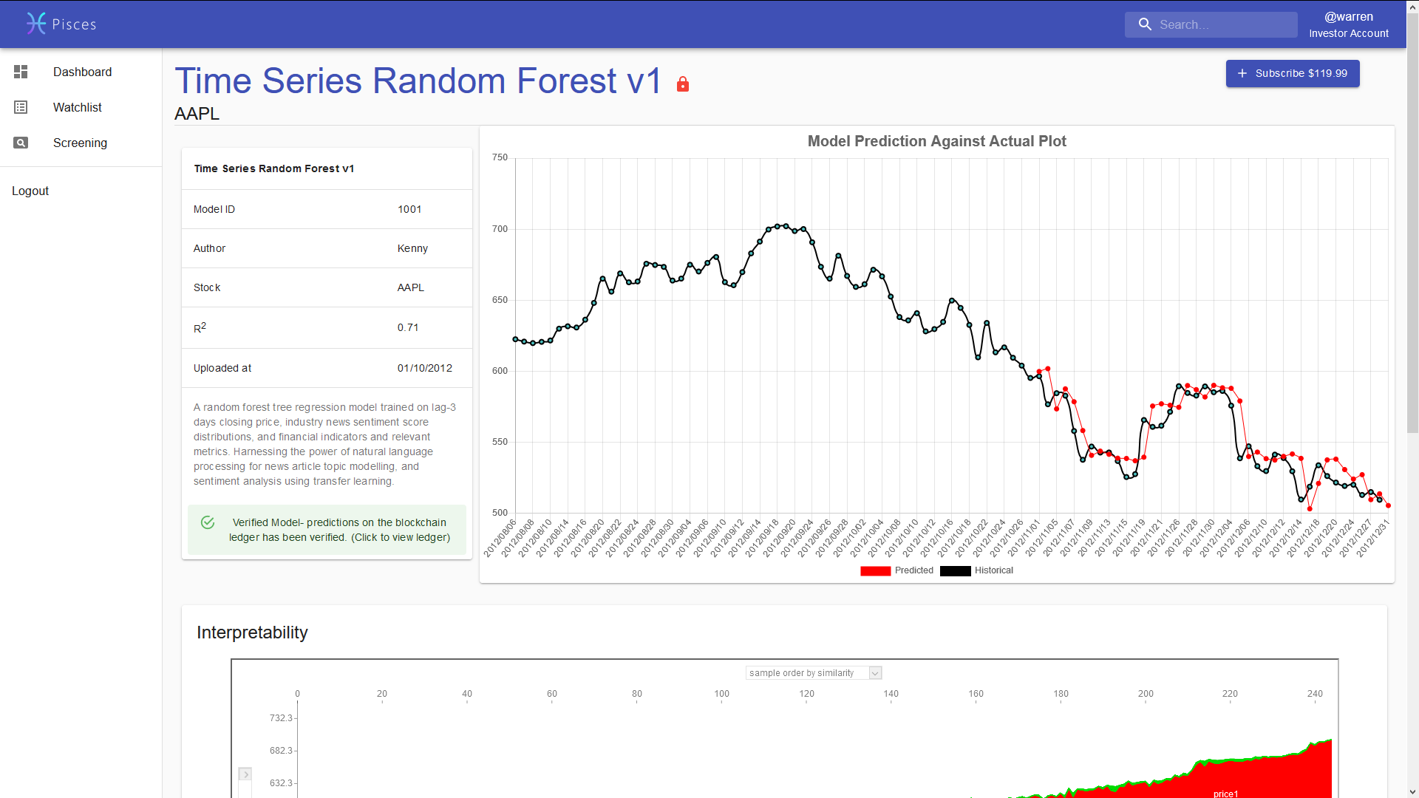
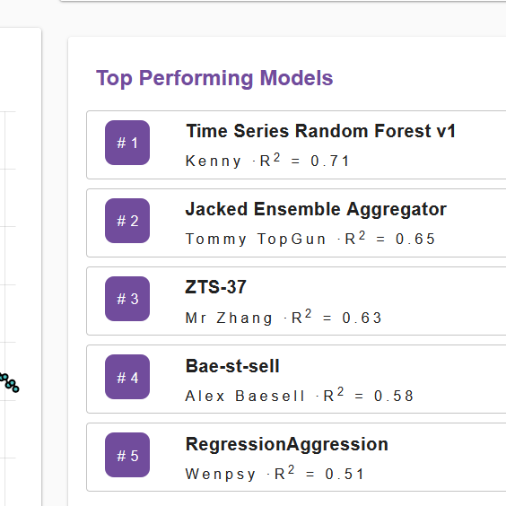
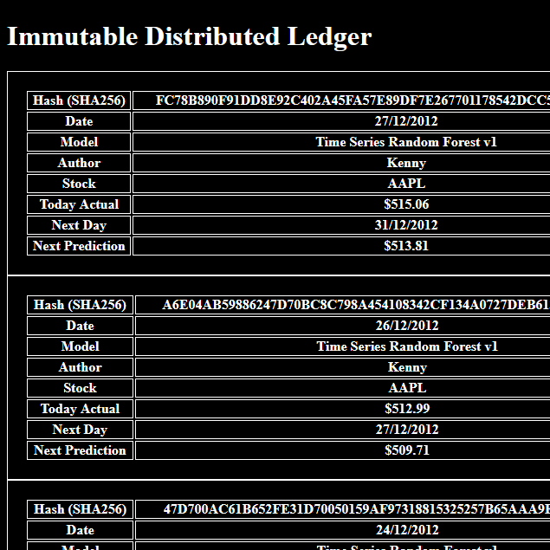
Prediction Models
Select a Model
View Performance
Verify in Blockchain

Slide 11
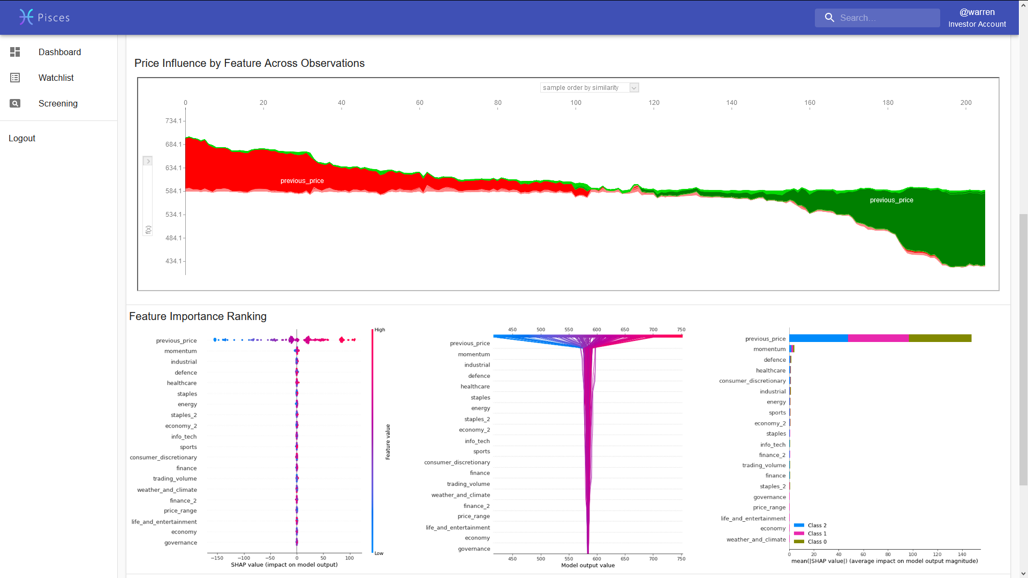
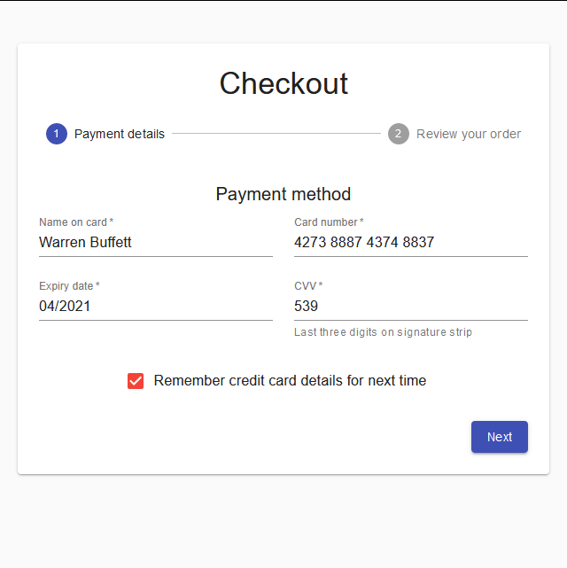
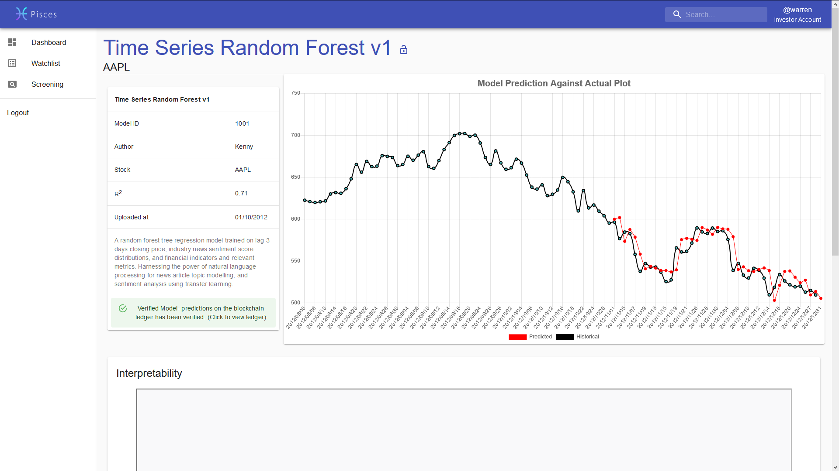
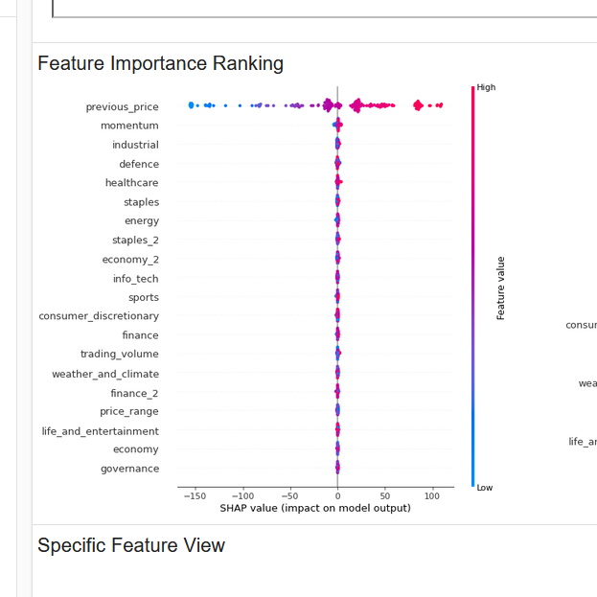
Stock Prediction and Interpretation
Subscribe Model
View Prediction
Interpret Model

Slide 12
Contributor’s Experience

Slide 13
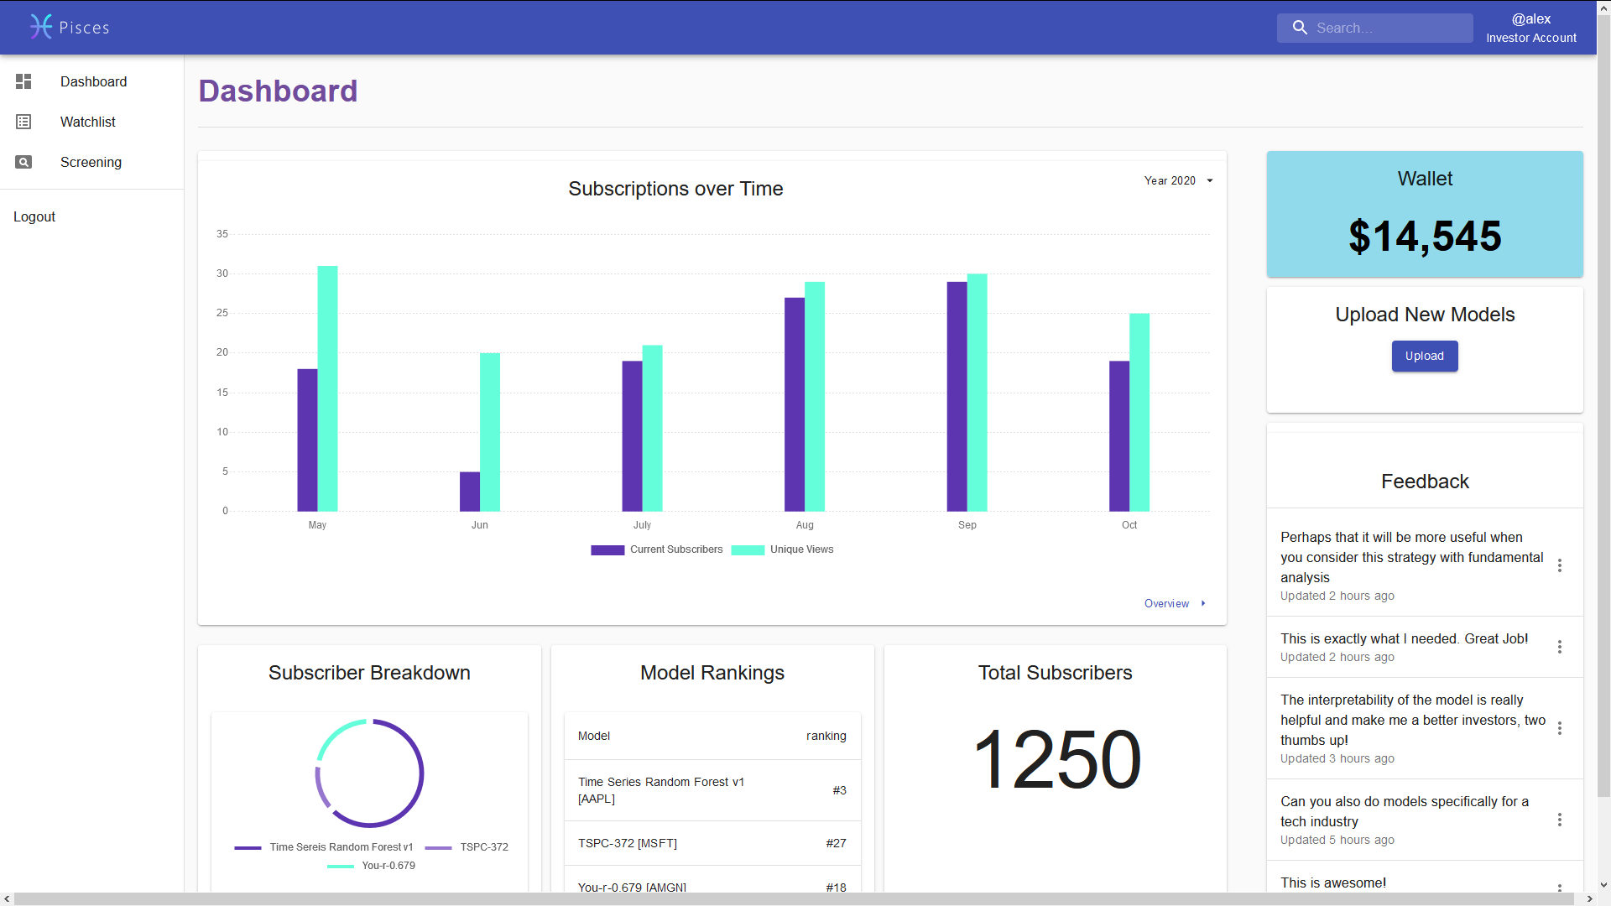
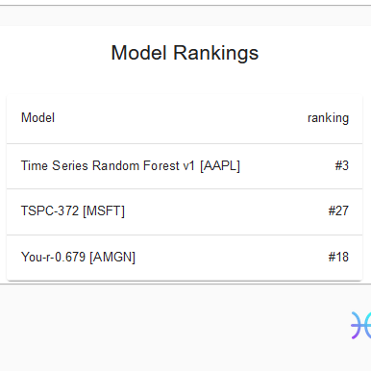

Contributor’s Features
Upload Model
View Model Rank
Read Feedback

Slide 14







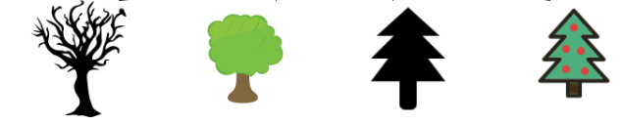






Slide 9
Prediction Model Process Overview
S&P 500 Stock Data
Technical Analysis
Pisces
Pisces Interpretation Engine (PIE)
Random Forest
Regression
~140k
Bloomberg News Articles
Topic Modelling with Latent Dirichlet Allocation
Sentiment Analysis with
Vader Sentiment Analysis

Slide 15

Technical Analysis
stock data
Daily Price Range
Market Volatility
Trading Volume / Market Cap
Stock Market Disagreement
Stochastic Oscillator
Price Momentum, Overbought, Oversold Signal
MACD, Signal Line, Crossovers
Possible Bullish, Bearish trend

Slide 16

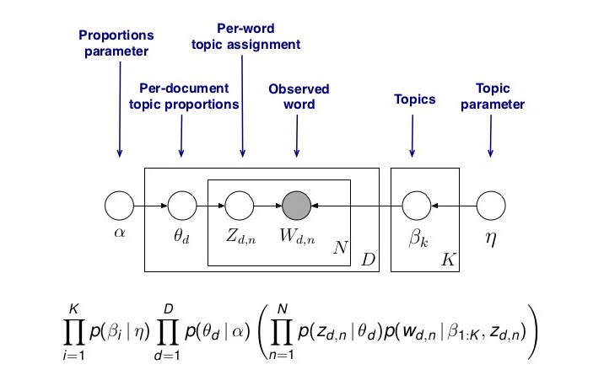
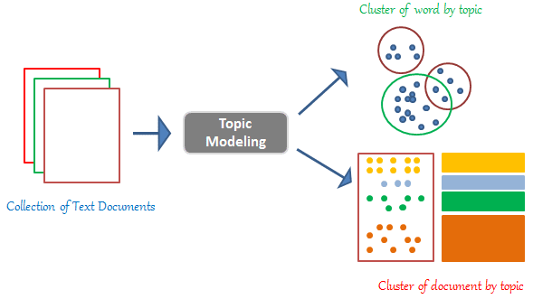
Latent Dirichlet Allocation Topic Modelling
News articles
A probability distribution model that assumes similar words make up similar topics, and several topics make up a document.

Slide 17
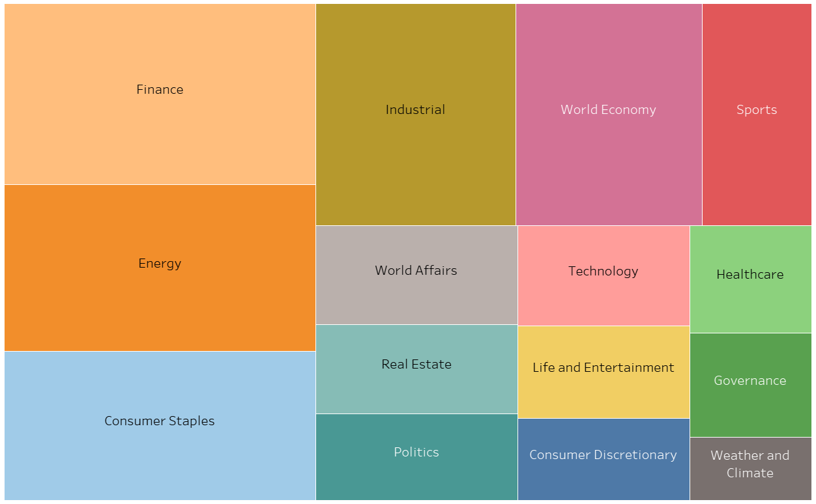
Topic Modelling Results
News articles
Distribution of Bloomberg News Articles by Topic in 2012

Slide 18


Sentiment Analysis with Vader
News articles

Slide 19

Sentiment Analysis with Vader
Sentiment analysis applied to Bloomberg news articles
Valence-aware lexicon-based approach using a curated dictionary of word to sentiment scores
Takes into account:
Punctuation
Capitalization
Degree modifiers
For Example:
“Swiss Exchange Trading Open Delayed Due to Unspecified Technical Problems”
[Overall Score: -0.6452]
"Swiss Exchange Trading Open SEVERELY DELAYED Due to Unspecified Technical Problems!!!“
[Overall Score: -0.8733]
News articles
-0.4019
-0.2263
multiplier * -0.4019
multiplier * -0.2263

Slide 20
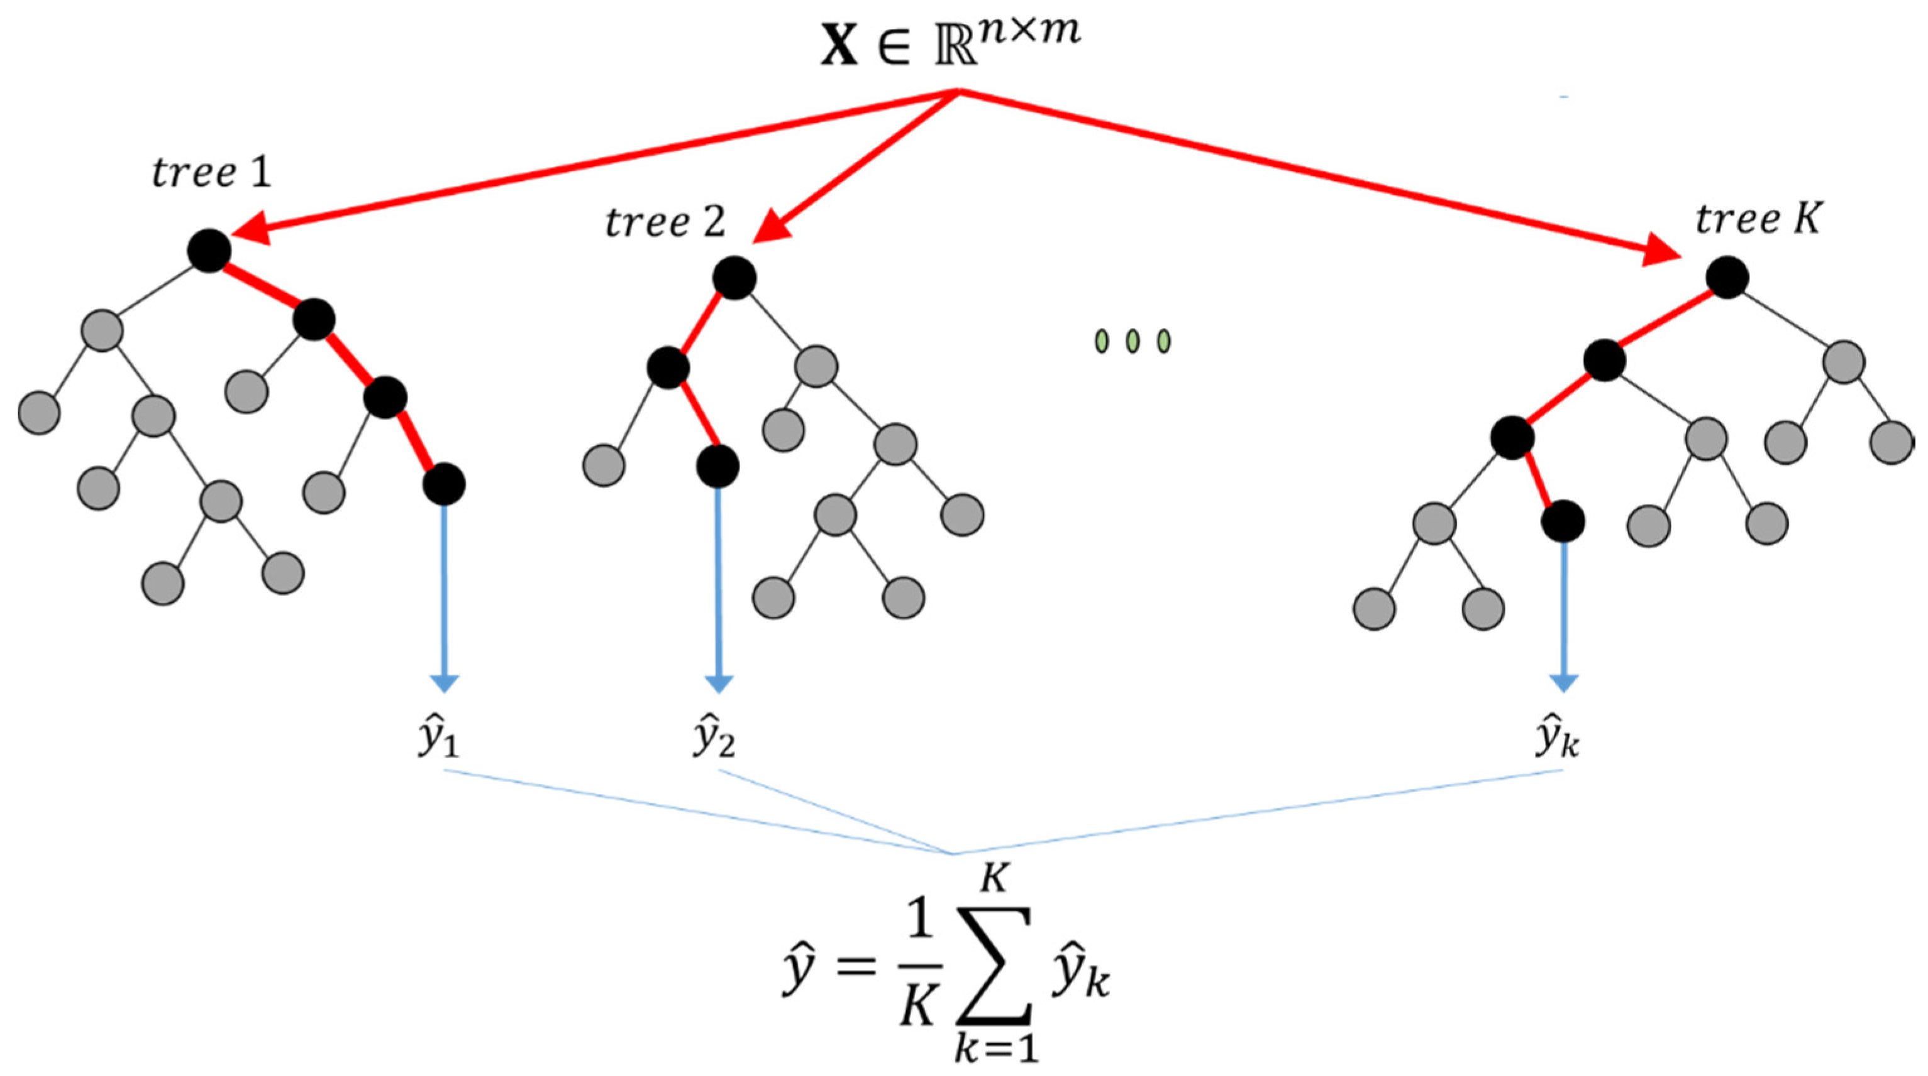
Random Forest Regression
Relies on the "wisdom of crowds" approach to find an average prediction
Performs bootstrap aggregation on features and observations
Features Used:
Technical Analysis Features in the preceding 3 days
Averaged Sentiment Scores Across Topics in the preceding 3 days
Stock price in the preceding 3 days

Slide 21

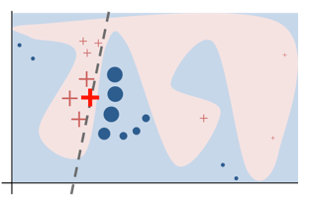
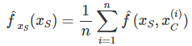
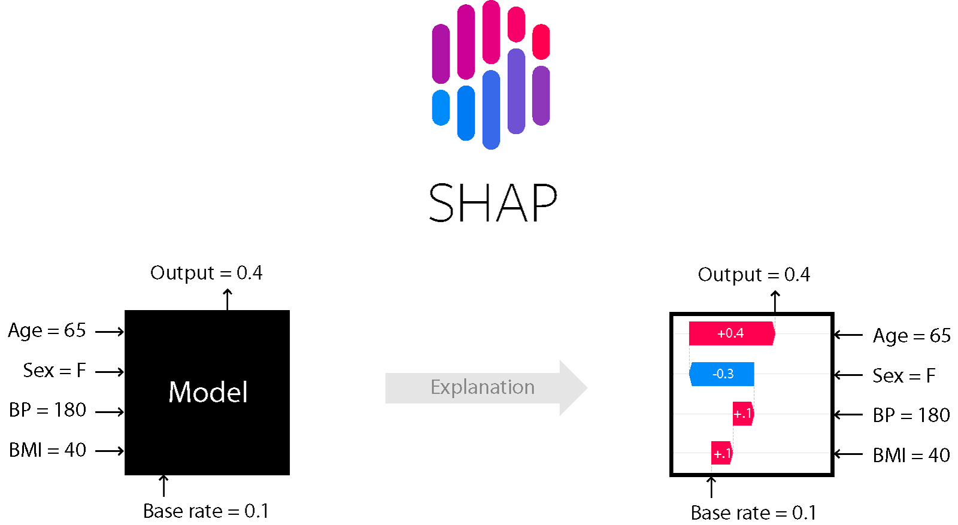
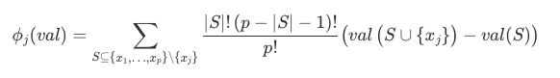
Pisces’ Model Interpretation
Linear Regression
Interpretable Model
Logistic Regression
Decision Tree
Interpretable Models
Decision Rules
Target
AI
Complex Model
Global Surrogate
Features
Pisces
Surrogate Model
Local Surrogate (LIME)
Target
Model Blackbox
Pisces Interpretation Engine (PIE)
Partial Dependence Plot (PDP)
Model-Agnostic Methods
Permutation Feature Importance, ALE, ICE, etc …
Shapley Values
Shapley Additive exPlanations (SHAP)

Slide 22
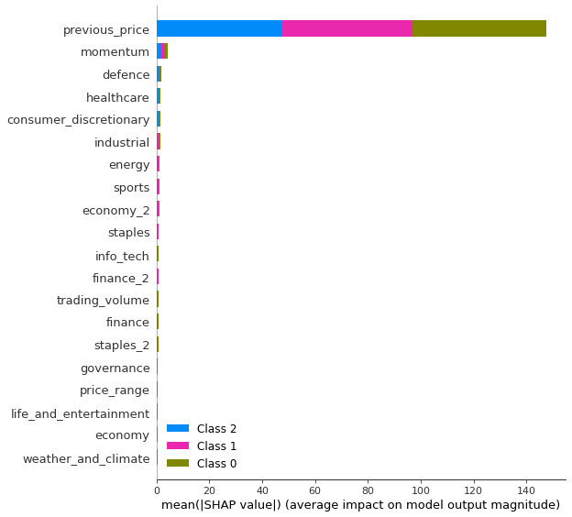
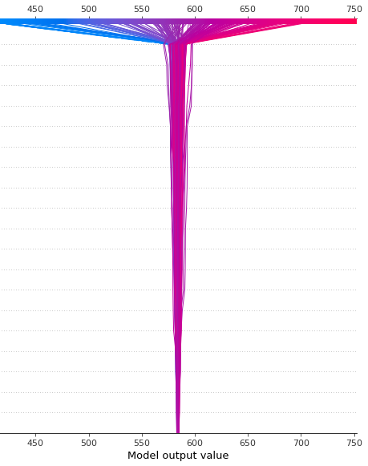
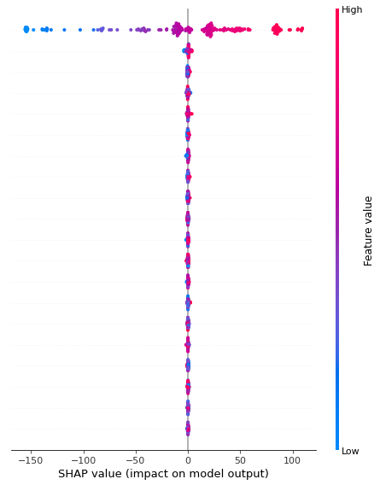
How Do Price Influencers Contribute Differently In General?
General Feature Ranking View
Bar Plot
Decision Plot
Beeswarm Plot
Horizontal axis: Population Average SHAP Value
Vertical axis: Feature Ranking
Compares the total feature impact on predicted day 0, day 1 and day 2 price
Horizontal axis: Price
Vertical axis: Feature Ranking
Shows how model accumulates features’ impact and arrives at prediction step by step
Horizontal axis: SHAP Value
Vertical axis: Feature Ranking
Shows how the relative impact of each feature is distributed across observations
High Impact
Negative(-) Impact
Positive(+) Impact
Top price influencers are ranked by importance.
day 0 prediction
day 1 prediction
day 2 prediction
Low Impact

Slide 23
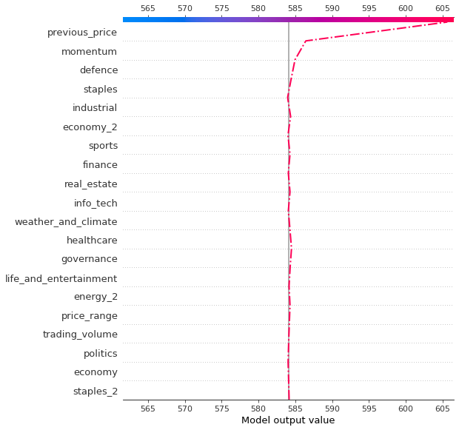
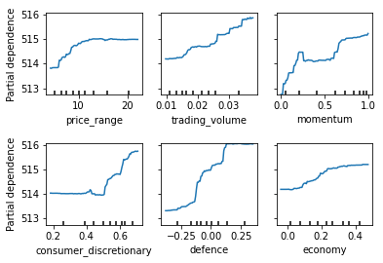
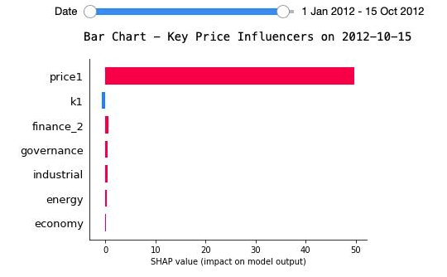
How Do Features Impact Price For a Given Day?
How Does Price Respond To A Specific Feature?
Specific Day View
Specific Feature View
Bar Plot Slider
Decision Plot
Partial Dependence Plot
Horizontal axis: SHAP Value
Vertical axis: Key Feature Ranking
Compares relative feature impact on a date chosen by user
Horizontal axis: Price
Vertical axis: Feature Ranking
Shows how model accumulates features’ impact and arrives at prediction step by step
Horizontal axis: Feature Value
Vertical axis: Price
Shows how price responds to individual feature in absolute correlations
Negative(-) Impact
Positive(+) Impact

Slide 24
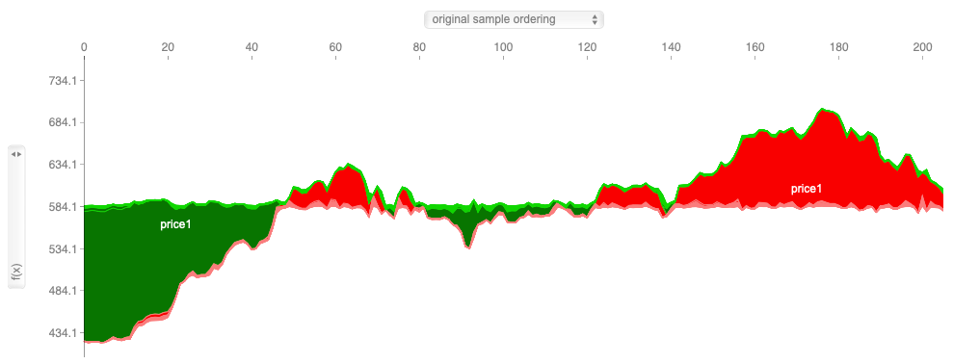
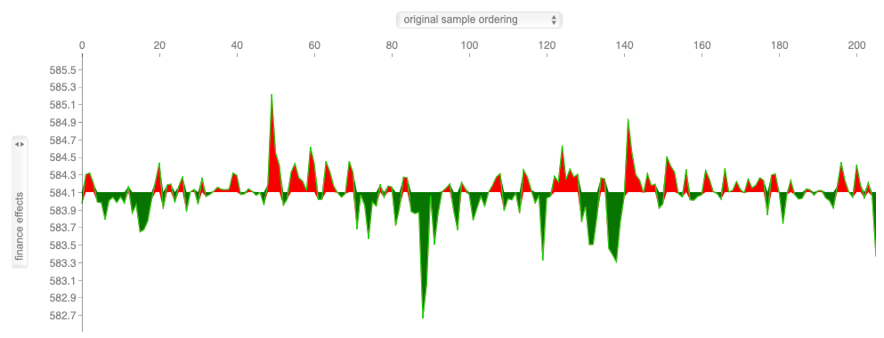
How Do Features’ Contribution Change With Time?
Price Movement with Time Interactive View
They may also change the sample ordering from the dropdown list on the top.
Horizontal axis: Observation Count, i.e. Date
Vertical axis: Feature Ranking
Allows users to view how relative contribution of price influencers on price change across days
Users can use the dropdown list on the left to choose which feature they want to investigate.

Slide 25
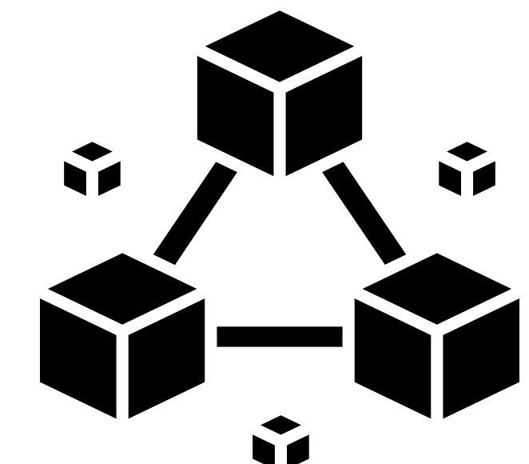




System Architecture
Modular Design - Modifiability
Front End
Back End
Public Ledger
Trust
Cache Layers
Web Server
Pisces System
Prediction Record Upload
View Analytics & Insights
Investor
API
Model prediction and evaluation
Prediction Record Retrieval
Investor
User Request
Model Contributor
Prediction interpretation
Contribute Data & Predictive Models
User Data Request
Third Party Data Provider
Data Contributor
- Company Fundamental Data
- News articles
Contributor
Server Response
Financial data and news articles
Monitor and Maintain the Platform
Visualization
User Data Request
Database
Market Sentiment
Platform Manager
User Data Response
Platform Manager
Performance
Load Balancers
Reliability & Scalability

Slide 26

Win – Win - Win
Investor
Access to a range of models with explainable predictions
Trusted model performance through blockchain proof
Pay per model subscription
Contributor
Monetisation of data and prediction models
Transparent evidence of model performance
Immutable proof of data and model ownership
Margin on model subscription enables sustainable revenue
Low risk business model

Slide 27



Drive ML adoption for financial industry
Enable collaboration through capitalisation
Protect originality and build trust via Blockchain ledger

Slide 28







Thank you!
Pisces
Alexander
Baesell
Liow
Jia Chen
Ken
Cheah
Tommy
Kangdra
Yu
Wenxi
Zhang
Tongsen

